Slide 1


Mini Project Id 2024MP_CSEPID021
“Clouderator”
Department of Computer Science & Engineering
PRESENTED BY:
1. Students Name:-Satyendra Kumar
Roll No: 2402900100269
2. Students Name:-Shivank
Roll No: 2402900100282
3. Students Name:-Shiv Narayan Yadav
Roll No:2402900100277
SUPERVISED BY:
Satyendra Singh
ABES Institute of Technology , Ghaziabad
Affiliated to:
DR. A.P.J. Abdul Kalam Technical University
Session 2026-27

Slide 2
Table of Content
1.Introduction
2. Objective
3. Literature Survey
4. Problem Statement
5. Proposed Solution (Methodology)
6. Mapping with SDGs Goals
7. References

Slide 3
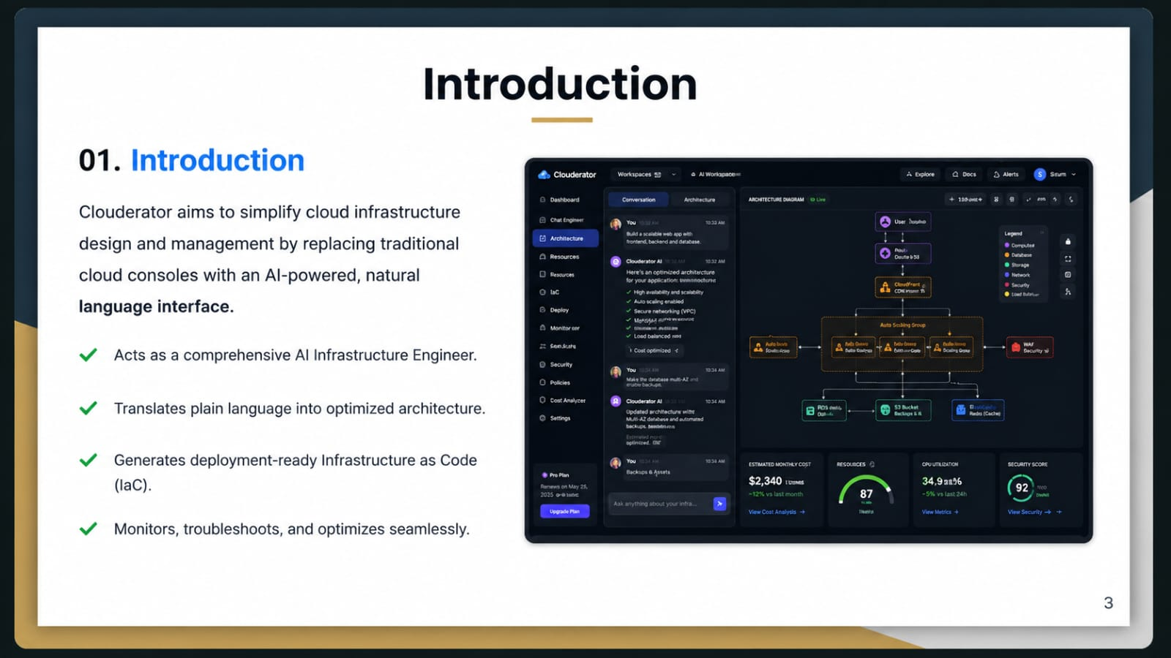
Introduction

Slide 4
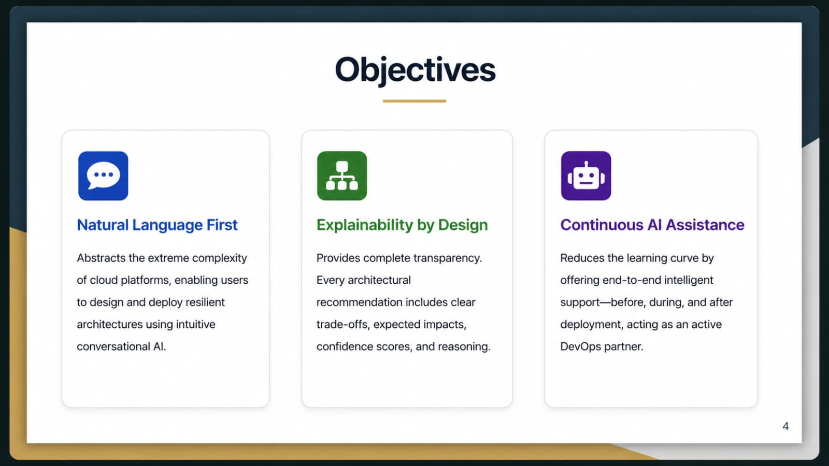
Objectives

Slide 5
Literature Survey

Slide 6
Problem Statement

Slide 7
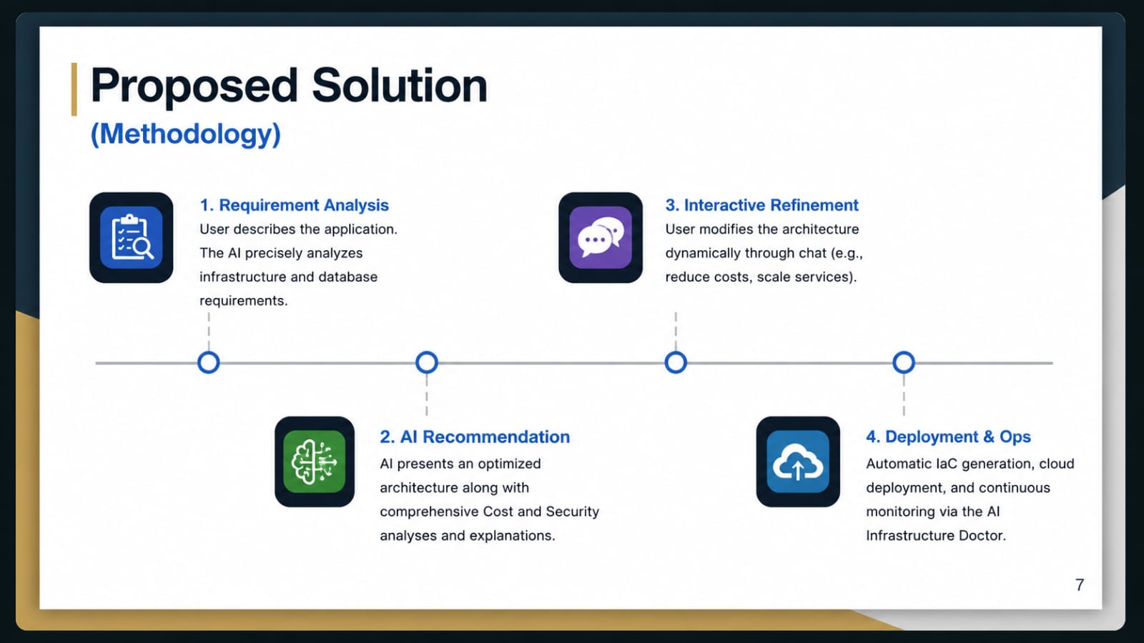
Proposed Solution

Slide 8
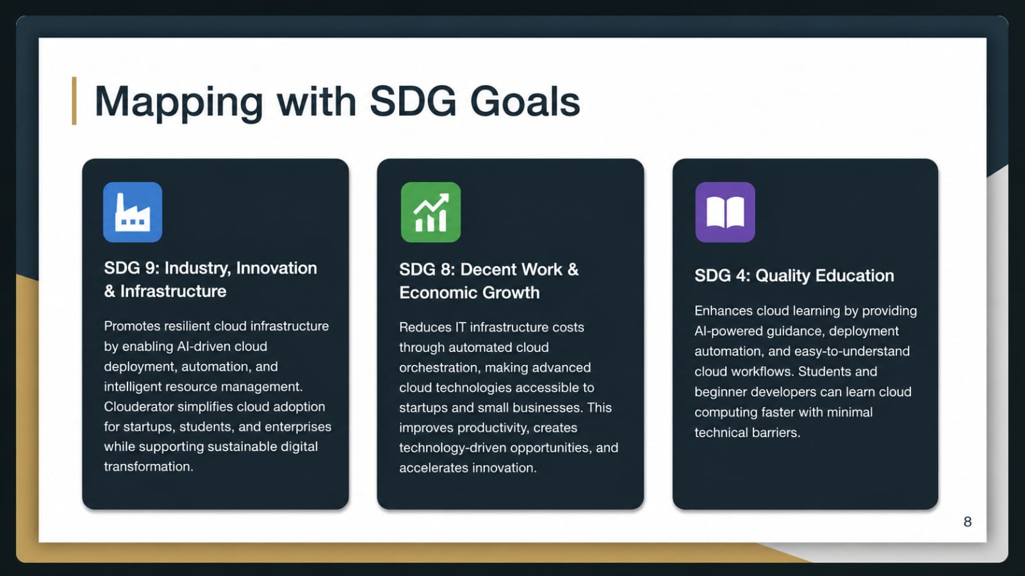
Mapping with SDG Goals

Slide 9
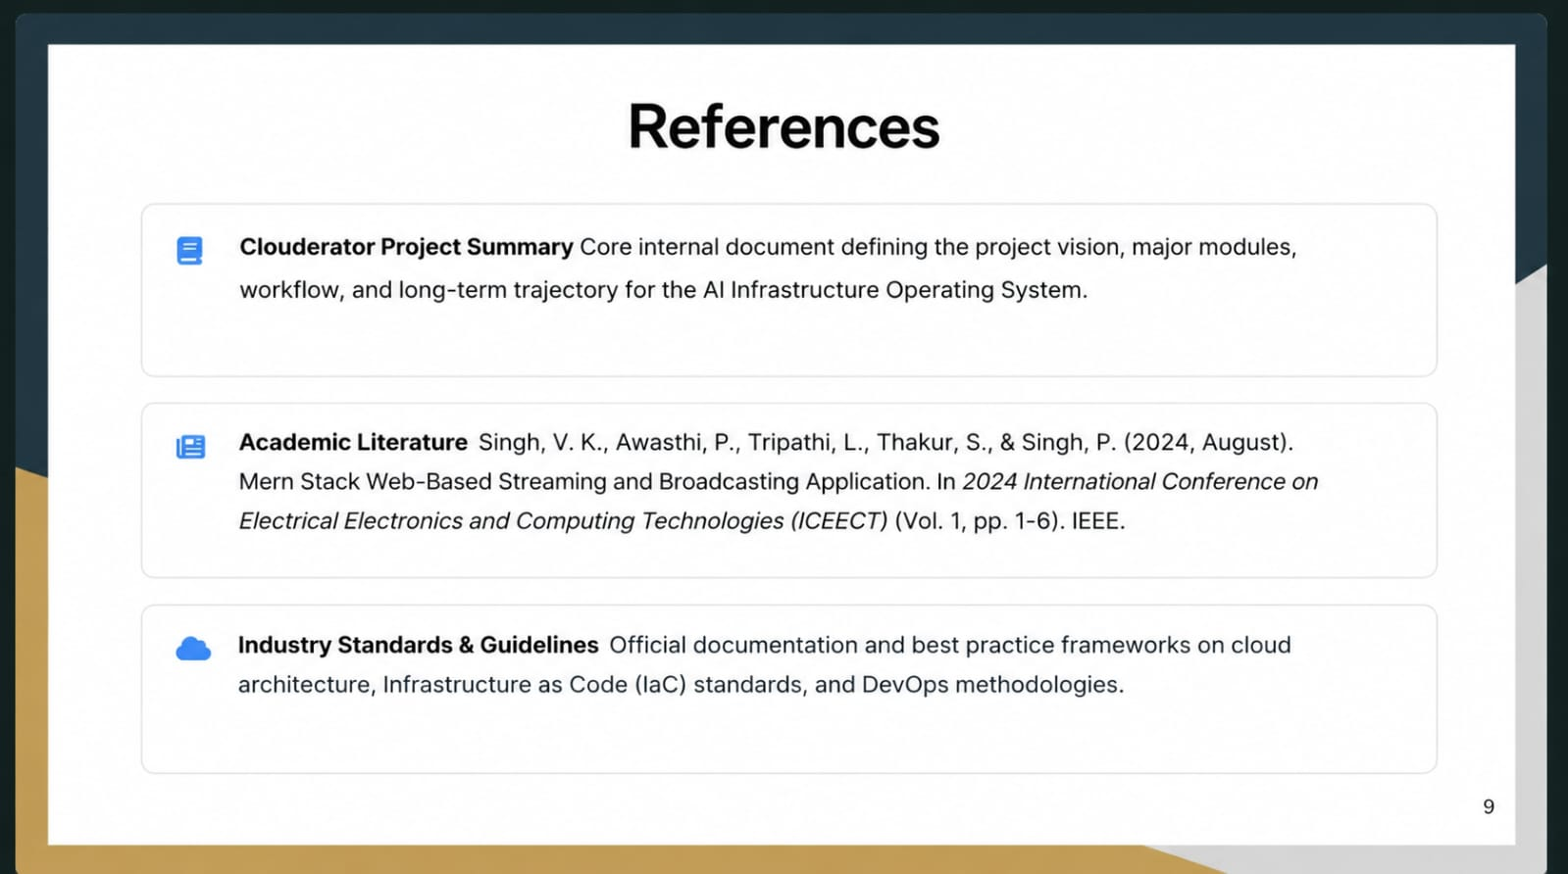
References
1. Singh, V. K., Awasthi, P., Tripathi, L., Thakur, S., & Singh, P. (2024, August). Mern (Mongodb, Express-Js, React-Js, Node-Js) Stack Web-Based Streaming and Broadcasting Application. In 2024 International Conference on Electrical Electronics and Computing Technologies (ICEECT) (Vol. 1, pp. 1-6). IEEE.

Slide 10
Thank you!

